Slide 1
Lesson plan Slide; NA Complete recall questions, feedback Learning journey Answers TEACHER TALK OPTION 1 - explain the different branches of Christianity OPTION 2 - explain the different branches of Christianity Use the information sheets to complete the table Consider similarities and difference between the denominations Share possible answers Focus on the differences between Baptists and Catholics, take feedback, highlight baptism Consider Catholic baptism, answer questions Consider Baptist baptism, answer questions Feedback and check answers Plenary
By the end of the lessons students need to know;
That there are a range of Christian denominations in the USA
That they express their faith in different ways, may have different sources of authority and that there are similarities and differences between them
Catholic, Baptist, LDS and Amish are the key groups to consider
That Catholics and Baptists have different methods and understanding of the practise of baptism
What these are
Why they differ

Slide 2


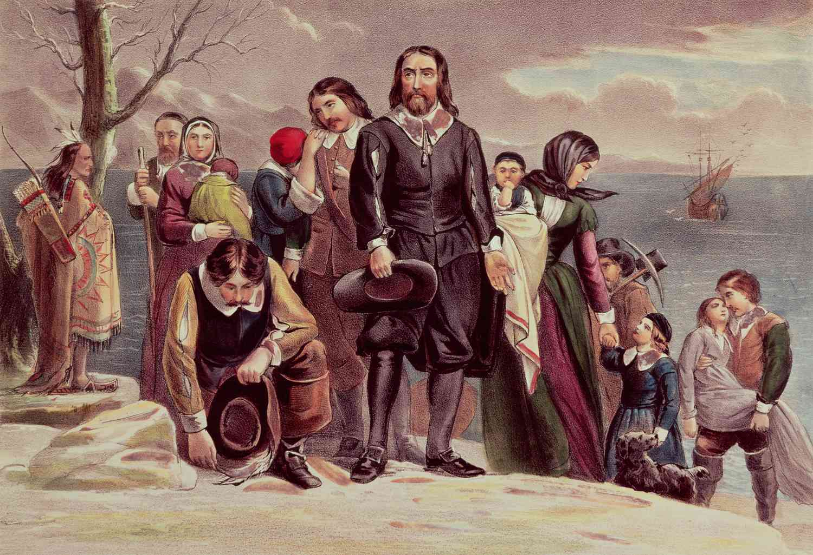
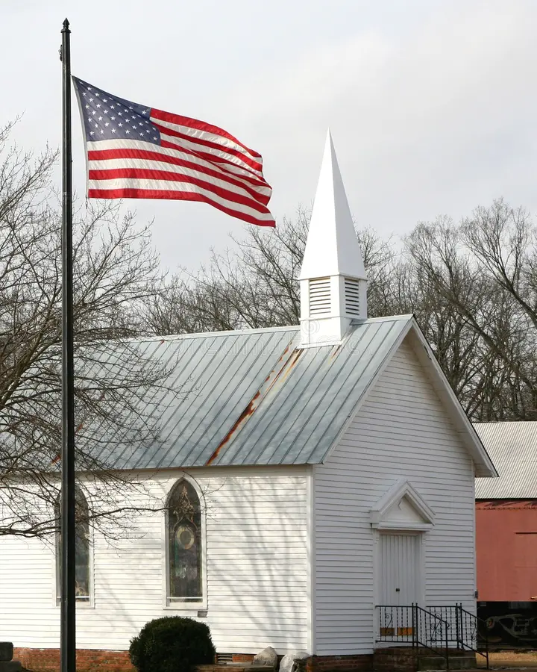

What are the largest Christian groups in the USA?
Which groups of settlers brought Christianity to the USA?
Which Christian group is the largest in the most states?
Can you remember the names of any other Christian groups in the USA?
Lesson question; What are the largest Christian groups in the USA?
Topic question; Why don't all Christians express their religious tradition in the same way?

Slide 3












Unit 5 - Why don't all Christians express their religious tradition in the same way?
7. How are religion and politics connected in the USA? *
6
6. Why is the Prosperity Gospel controversial?
4. What is the history and development of the Church of Jesus Christ of Latter Day Saints?
7
Core concepts
Belief
4
Wisdom and authority
Community
5
2. What are the largest Christian groups in the USA?
5. What is the history and development of the Amish?
2
3
How diverse is Christianity in the USA?
3. What do fundamental Christians believe about creation?
1

Slide 4

What are the largest Christian groups in the USA?
Which groups of settlers brought Christianity to the USA?
Spanish, Dutch, French, English
Which Christian group is the largest in the most states?
Catholic
Can you remember the names of any other Christian groups in the USA?
Protestant, Baptist, Latter-day Saints, Orthodox
Lesson question; What are the largest Christian groups in the USA?
Topic question; Why don't all Christians express their religious tradition in the same way?

Slide 5
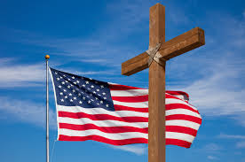
What are the largest Christian groups in the USA?
As we began to look at last lesson, Christianity in the USA is not just one group, denomination or church.
It is made up of different traditions, each shaped by history, migration and beliefs.
Today we are going to look at 5 groups.
Lesson question; What are the largest Christian groups in the USA?
Topic question; Why don't all Christians express their religious tradition in the same way?

Slide 6
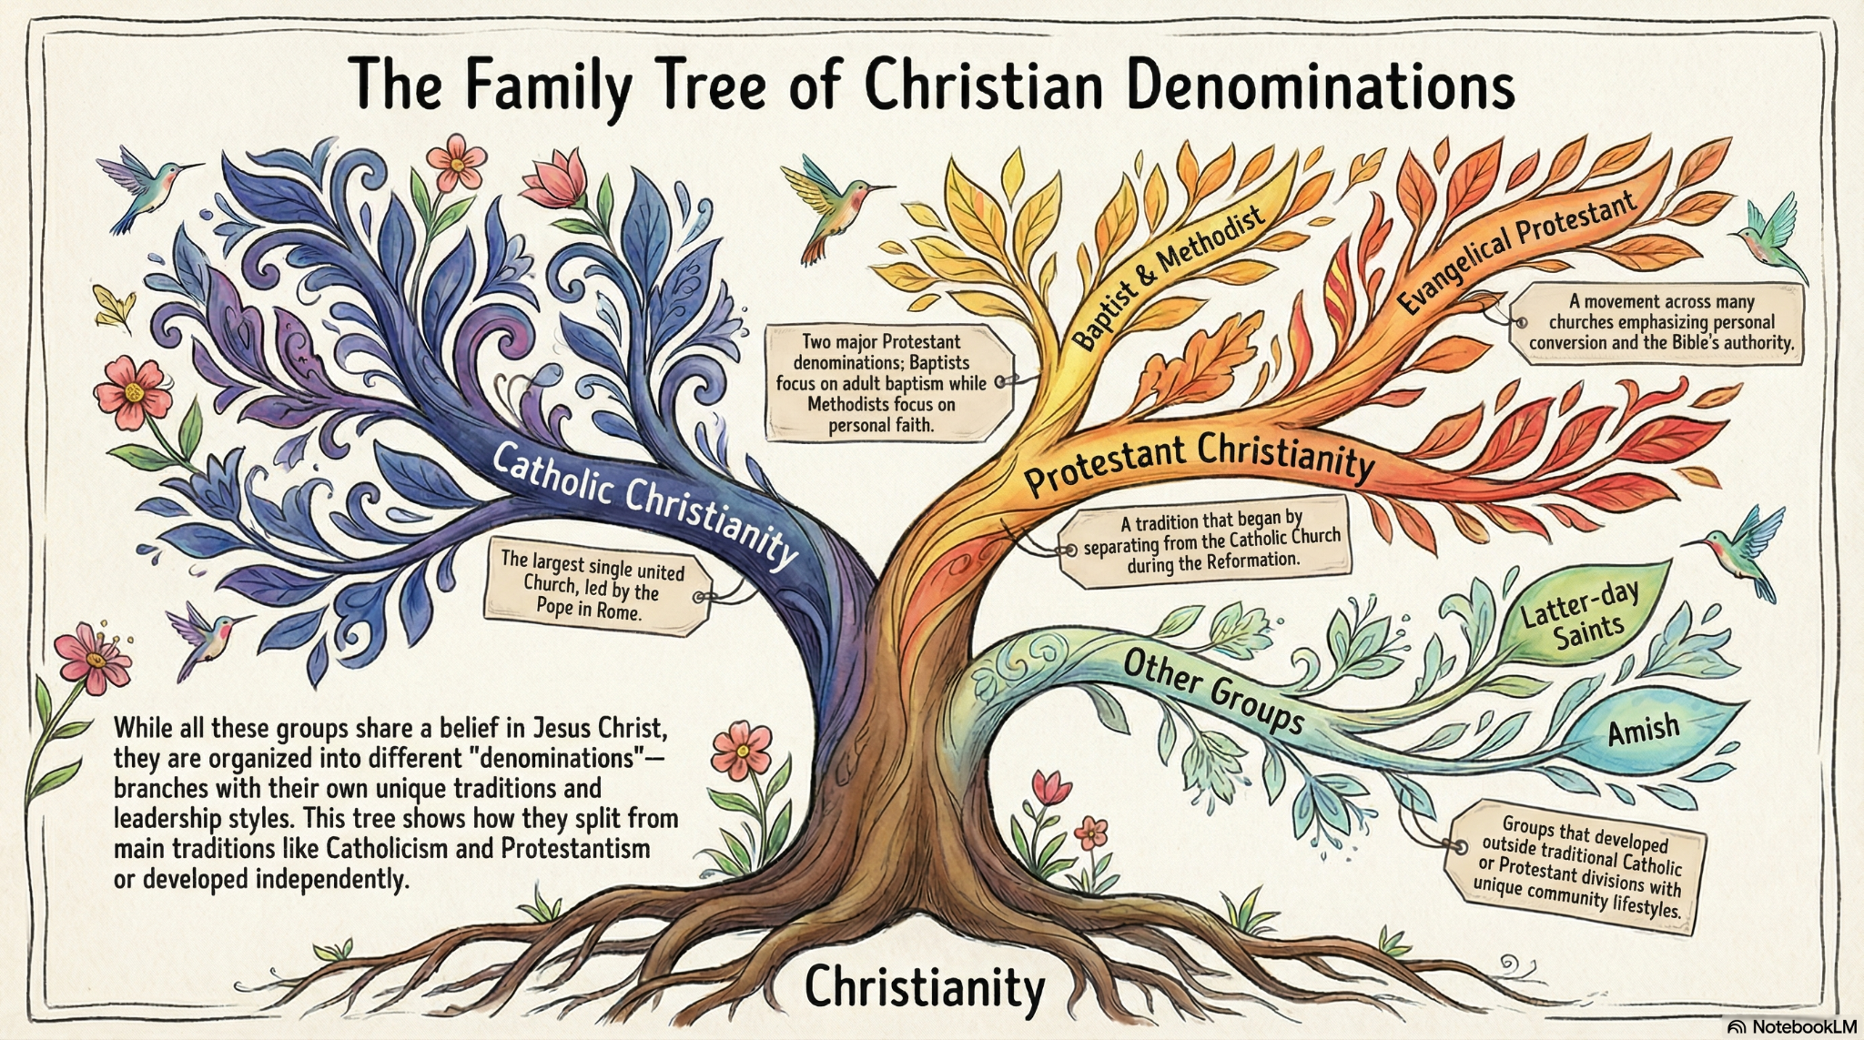
What are the largest Christian groups in the USA?
Lesson question; What are the largest Christian groups in the USA?
Topic question; Why don't all Christians express their religious tradition in the same way?

Slide 7

What are the largest Christian groups in the USA?
Catholic | Protestant |  |  | Other Christian groups
The Catholic Church traces itself back to the the time of Jesus and sees the Pope as their spiritual leader. | Protestant churches split from the Catholic Church during the Reformation in the 1500s because they wanted to follow the Bible more directly and have independent local churches. |  |  | Groups like the Latter-day Saints and the Amish developed later within Christianity.
Catholic | Evangelical Protestant | Baptist | Methodist | Latter-day Saints | Amish
Largest single Christian denomination, tracing its history, with worship centred on sacraments, the Pope, and formal worship. | Focused on personal faith, the authority of the Bible, being “born again,” and sharing their beliefs with others. | Only adults are baptised, focuses on preaching and Bible study, and values local church independence. | Personal faith, social action, and structured worship are important. | Founded in the 1830s, following the Bible and the Book of Mormon, with strong family and community practices. | Focuses on technology-free living, home-based worship, and tight-knit community life.
Together, all these groups are Christian because they follow Jesus, but they have different histories, beliefs, and ways of practising their faith.
Lesson question; What are the largest Christian groups in the USA?
Topic question; Why don't all Christians express their religious tradition in the same way?

Slide 8
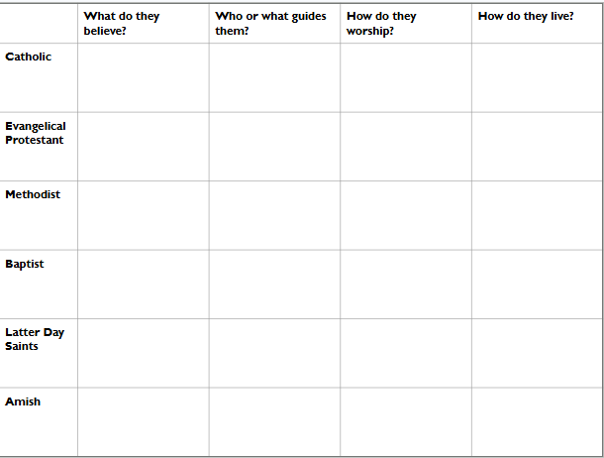
What are the largest Christian groups in the USA?
While all these groups are Christians, they practise their faith differently, place importance on different things and live their lives differently, according to their various beliefs.
Use the information around the room to complete the table about 6 different Christian traditions.
Lesson question; What are the largest Christian groups in the USA?
Topic question; Why don't all Christians express their religious tradition in the same way?

Slide 9


What are the largest Christian groups in the USA?
What similarities and differences do you see between these denominations?
Lesson question; What are the largest Christian groups in the USA?
Topic question; Why don't all Christians express their religious tradition in the same way?

Slide 10
What are the largest Christian groups in the USA?
Similarities
Belief in Jesus and salvation
Use of the Bible
Community and family focus
Similar rituals, although they may differ in style
Differences
Baptism
Worship style
Authority
Lifestyle focus; charity, family, evangelism, helping others. Bible study ect
Lesson question; What are the largest Christian groups in the USA?
Topic question; Why don't all Christians express their religious tradition in the same way?

Slide 11
What are the largest Christian groups in the USA?
Look back at Baptists and Catholics now - what differences do you notice?
Both Baptists and Catholics baptise people into the faith, but they do this at different times and in different ways.
Let’s look at these now and think about what happens, and what is different.
Lesson question; What are the largest Christian groups in the USA?
Topic question; Why don't all Christians express their religious tradition in the same way?

Slide 12

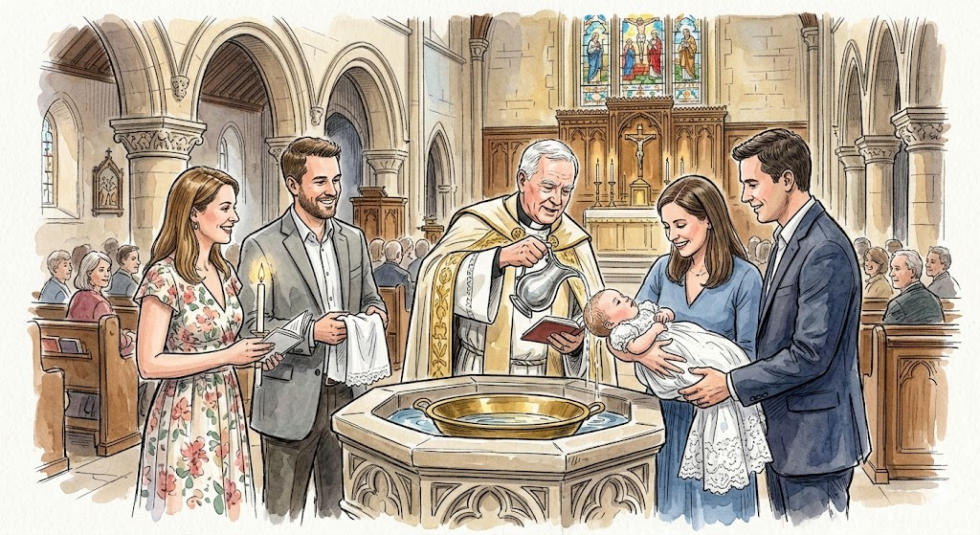


What are the largest Christian groups in the USA?
Catholic Baptism
What happens?
Who is baptised?
Why are they baptised?
What happens?
Who is baptised?
Why are they baptised?
Lesson question; What are the largest Christian groups in the USA?
Topic question; Why don't all Christians express their religious tradition in the same way?

Slide 13
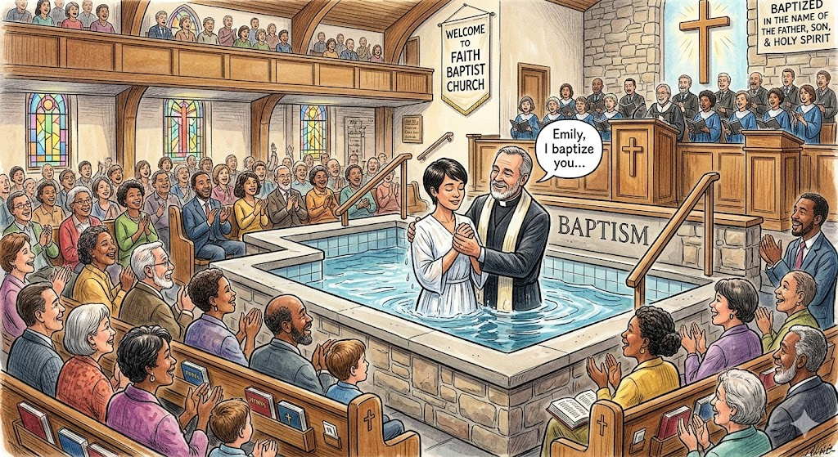
What are the largest Christian groups in the USA?
Believers Baptism
What happens?
Who is baptised?
Why are they baptised?
Lesson question; What are the largest Christian groups in the USA?
Topic question; Why don't all Christians express their religious tradition in the same way?

Slide 14
What are the largest Christian groups in the USA?
Catholic baptism | Believers baptism
1. What happens? Catholic: Water is poured on the baby’s head, and special words are said. It is a sacrament, meaning God’s grace is received through this ritual. 2. Who is baptized? Catholic: Babies, with their parents’ permission. 3. Why are they baptized? Catholic: To welcome them into God’s family and the Church, and to begin receiving God’s grace from the start of life. | 1. What happens? Baptist: The person is fully immersed in water (completely goes under). 2. Who is baptized? Baptist: People old enough to choose to follow Jesus themselves (older children or adults). 3. Why are they baptized? Baptist: To show they have personally chosen to commit to God, obey His teachings, and start a new life with Jesus.
Lesson question; What are the largest Christian groups in the USA?
Topic question; Why don't all Christians express their religious tradition in the same way?

Slide 15
What are the largest Christian groups in the USA?
What are the key differences between the largest Christian groups in the USA?
What are the key differences between baptism in the Catholic and Baptist Church?
Lesson question; What are the largest Christian groups in the USA?
Topic question; Why don't all Christians express their religious tradition in the same way?

